Slide 1
ACCREDITATION : STANDARDS, ACCOUNTABILITY, AND ASSURANCE FOR QUALITY EDUCATION
May 28, 2016

Slide 2
2
3
1
Let’s self-evaluate through time!
What inference can we make?

Slide 3
1ST PATH: (INTERNAL) SCHOOL IMPROVEMENT PLAN-SIP
Posing Questions:
“Where do we stand? What can we do to perform better? What is our vision of our school?”
Qualitative and Quantitative Research:
Collecting data and feedback through surveys, observations , performance results , etc..
Strategic Planning :
Analyzing all kinds of data and setting goals accordingly in alignment with vision
Implementing/ Executing Plan:
Allocating tasks , monitoring, and recording outcomes
Reevaluating :
Reviewing and assessing plan and execution process; recording results and conclusions

Slide 4
2ND PATH: (EXTERNAL) Quality Control

Slide 5
✓ Standards ✓ Accountability ✓ Assurance

Slide 6
Standards and Assurance with:

Slide 7
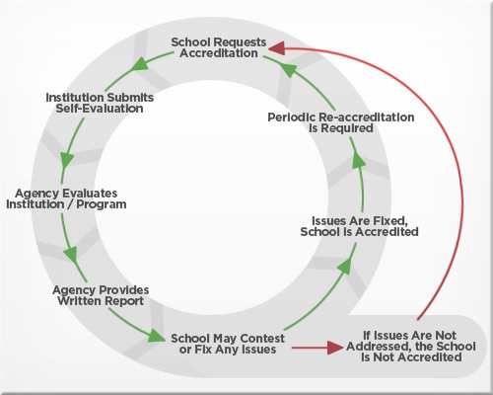
The Accreditation Process

Slide 8
Accreditation Organizations
New England Association of Schools and Colleges
Middle States Association of Colleges and Schools
AdvancED
(Southern Association of Colleges and Schools, Council on Accreditation and School Improvement - North Central Association Commission on Accreditation and School Improvement - Northwest Accreditation Commission )
1

Slide 9
2
DfE
Ofsted
7 Organizations

Slide 10
3
French Secular Mission
The Network for French Teaching Abroad
Mission laïque française OR
Agence pour l'enseignement français à l'étranger OR
Ministre des Affaires étrangères France OR
Ministry of Foreign Affairs – France

Slide 11
4
Bundesverwaltungsamt OR
Deutsche Auslandsschularbeit International OR
Central Agency for German Schools Abroad
Federal Office of Administration

Slide 12
BASIC ACCREDITATION TERMINOLOGY
Self-evaluation
Standards
Three Axis
Assurance
UK Inspection-based Approval
Accountability
Inspection Report
External Review
Five Main Standards / Indicators
Nine Standards for Inspection / Descriptors
Accredited Member
Profile as a Whole
Bodies
Lead Evaluator
Lead Inspector
Committees

Slide 13
BENEFITS OF ACCREDITATION
Chance for self-evaluation
More reliable observations and data analysis (research-based approaches)
Self-regulating school improvement plans
Setting goals and systematically pursuing them
More efficient vision, mission, and values
More efficient decision-making
Collaborative and more involved efforts
Creating school team spirit

Slide 14
DO’S AND DON’TS
Avoid:
Allow:
Studying standards and criteria and implementing them
Resisting criteria that were not included in your school’s set of provisions
Considering accreditation as a process that puts limits to school’s innovation
Setting your school’s unique schemes, creating and maintaining your school’s identity
Including details in your self-evaluation reviews that are not evident in your school’s plans or not properly implemented
Forcing your school to apply for accreditation if you are not ready for the new schemes or unwilling to exert effort or be objective in your self-evaluation
Studying the organization’s standards and provisions to understand and accept its terms and codes
Including only details that can be supported with evidence
Working diligently for the external visit and neglecting systematic work after visit
Following a systematic, ongoing plans to maintain continuous improvement
Considering Approval the endpoint (especially in case of Probationary Accreditation)
Continuous improvement plans (to avoid termination of accreditation)

Slide 15
QUESTIONS AND ANSWERS
For more info: Manal Zeineddine manal.zd@gmail.com

