Slide 1

The power of extensive reading (ER) in creating better writers
Hanaa Jaber
ATEL- 2016

Slide 2
Our AGENDA:
Intensive VS Extensive Reading
Comprehensible Input
Benefits of ER
Principles of ER
Implications for the creating an ER program

Slide 3

Your Turn
What’s your favorite childhood story?
What was special about that story/ies?

Slide 4
Check Your Knowledge
IS IT EXTENSIVE OR INTENSIVE?
1. Reading in detail with specific learning aims and tasks
2. Purpose: a lifelong reading habit, enjoyment and general reading skills.
3. Rapid reading of large quantities of material or longer reading for general understanding.
4. Purpose: detailed meaning, developing reading skills vocabulary and grammar knowledge.
5. With respect to place and time, it’s OUT of the course.
6. With respect to place and time, it’s IN of the course.
IR
ER
ER
IR
ER
IR

Slide 5
ER
IR
Reading large quantities of material or long texts for global or general understanding with the intention of gaining pleasure from the text.
Reading a text in detail with the intent to understand all structures, lexis and text organization and at the same time developing reading skills.

Slide 6
What is Extensive reading
Extensive reading is defined by many scholars and researchers as reading large amounts of texts fluently and for meaning, and students mainly do it outside of the classroom for their own pleasure and enjoyment, at their own pace and level, and, most importantly, they choose the reading material that interests them.

Slide 7
the Common problem
Reading with understanding and writing have been challenging tasks for many EFL students, especially for low achievers in heterogeneous classrooms.
Problem
Limited reading/ No comprehension
Major Problems in writing
Frustration and low motivation
Students rarely read outside
Different proficiency levels

Slide 8
Writing Problems
Weak grammar usage and structure
Poor ideas/ chopped content
Poor vocabulary knowledge
Vagueness of content
Spelling Errors & poor orthographic knowledge

Slide 9


Stephen Krashen
When foreign language
Learners read for pleasure,
they can continue to improve
in their second language
without classes, without
teachers, without
study & even without
people to converse with.
Notes:
Choose a book – scan brochure, read the blurb, look at the cover, do a flip test, discuss whether your students would find it interesting or not.

Slide 10
The Input Hypothesis
To Krashen:
=
1. Language learning vs language acquisition
2. The focus is on Meaning rather than the form.
3. The input language is “a bit beyond” the current level of competence (i + 1).
4. Output will ‘emerge’ once the acquirer has built up enough comprehensible Input (picking up the language).
Comprehensible Input
the only true foundation of SLA

Slide 11
THE LANGUAGE SKILLS
Transfer of language items.
Frank Smith (1981) :“One learns to write by reading the writings done by others”.
Receptive Skills:
Listening Skill
Reading Skill
Productive Skills:
Speaking Skill
Writing Skill

Slide 12
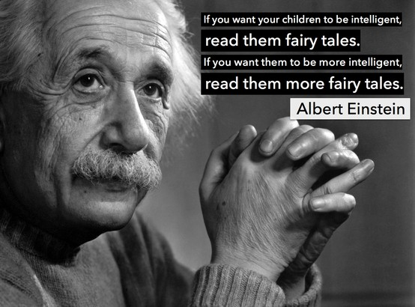
Read them MORE fairy tales!

Slide 13
Effects of Extensive Reading
SSR is not optional; it gives interesting sources of language.
Text comprehension is an excellent source for guessing unknown vocabulary.
The very act of reading can build children’s language and cognitive capacities.
Reading simplified material will develop skills naturally.
Acquiring language leads to better test results in reading, writing, vocabulary, and grammar
Enhancing the Cognitive skills and activating the prior knowledge helps in language learning.

Slide 14
Linguistic Knowledge
Linguistic knowledge
lexis
grammar
syntax
chunks
collocations
Spelling & punctuation

Slide 15
Readers’ Library:
Collection of different reading materials/ genres.
Individual students borrow books.
Read in their own time/ place/ pace/ choice.

Slide 16

Principles of ER

Slide 17
Principles of ER
These ten principles of ER founded by Day and Bamford (2002) are considered the milestone in any ER program:
1. “The reading material is easy”.
5. “The purpose of reading is usually related to pleasure, information and general understanding.”
2. “A variety of reading materials on a wide range of topics must be available”.
4. “Learners read as much as possible.”
3. “Learners select what they want to read.”

Slide 18
Principles of ER Cont’d
10. “The teacher is a role model of a reader for the students.”
9.
9. “Teachers orient and guide their students.”
6. “Reading is its own reward.”
7. “Reading speed is usually faster rather than slower.”
8. “Reading is individual and silent.”

Slide 19

Reading – Writing Relationship
Transfer of knowledge
Structures are internalized incidentally by repeated exposure
Reading builds writing schemata/ structures/ genres
Authentic, rich in content, enjoyable, and, above all, comprehensible.
Vocabulary & grammar are gained from exposure to meaningful language.

Slide 20
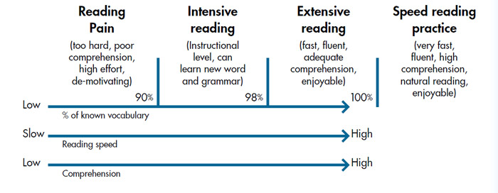
How to choose the level?

Slide 21

The Reading Material

Slide 22

Choosing the right book
Choose a book
Look at the cover
Read the blurb
Do a flip test
Is it interesting?

Slide 23
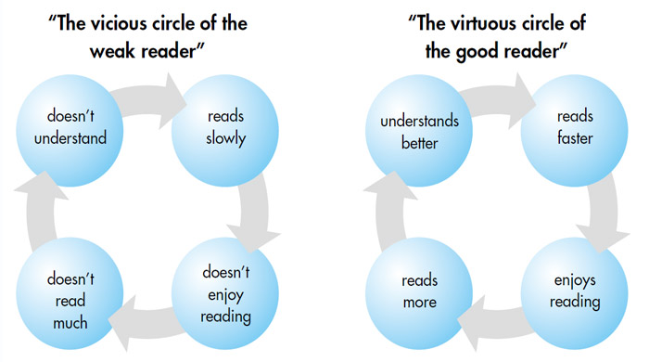
The Weak Reader VS The Good Reader

Slide 24
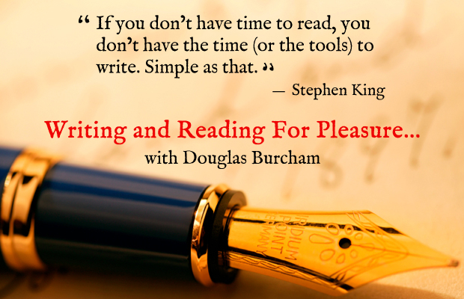

Slide 25
Benefits of ER
“Struggling learners in EFL classes are not marginalized when they are given the chance to improve at their own pace and without frustration.” (Cunningham & Stanovich, 2001)

Slide 26
Reading Fluency/ Rate
Reading Comprehension
Speaking Skill
Extensive Reading
(ER, FVR, IR, SSR…)
Grammar
Benefits: Improvements in…
Spelling/ orthography
Vocabulary
Writing Skill
Positive Attitudes
Literature Knowledge
Motivation to learn

Slide 27

Setting a program:
Setting up a Check-out System
Pre-reading activities/ scaffolding
Introduce choice/ procedure
Options for outcomes
Compiling the Reading Material

Slide 28
Assessing Writing
1. Content
4. Language Use
5. Mechanics
2. Organization
3. Vocabulary

Slide 29
Results of Post-Treatment Test
experimental group outperformed the control group.

Slide 30
The experimental group outperformed the control group.

Slide 32
Comparison of post-test scores on writing criteria of both groups

Slide 33
Impact of ER on Writing Quality
Increase in the amount of writing (richer content due to background knowledge).
Improvements in the organizational skills.
Progress in the usage of some idiomatic expressions and collocations.
Richer content and ideas,
Improvements in spelling,
Less grammatical mistakes and variety of sentence structures.
Improvements in writing conventions and mechanics.

Slide 34
Digital Stories
“Digital Storytelling is the modern expression of the ancient art of storytelling.” (Prof. Helen Barrett)
Storytelling is the oldest form of education.
Digital stories become memories that don’t easily fade away.
They usually include lots of digital elements, such as images, words, sounds, voices, hyperlinks and animation.
These digital elements add a magical touch to stories, as when they bring a fairy to life and make her wink, or sing and dance.
Learners can listen, read, speak, and write in response to a good digital story.

Slide 35
Motivation
High and long-lasting motivation will impel and thrust students to learn a foreign language well.
ER has influenced the learners’ perceptions through giving them the chance to have fun and practice a pleasurable activity at their own pace, level, preference, interest, and mostly important, at their own choice.

Slide 36
Pedagogical Implications and Recommendations
1. ER should be integrated in any EFL syllabus, done at any time and place.
2. Reading for pleasure should be a habit.
3. Teachers have to expose learners to a body of literature and train them to choose the appropriate material.
4. Our main role is to provide adequate input and a positive environment for acquisition to take place.

Slide 37
Pedagogical Implications and Recommendations
6. Provide the teachers and students with quality materials.
7. Highlight the advantages of reading in English and what benefits it offers to the language learners.
8. Educators raise the students’ awareness about the importance of writing with good quality, good language, and powerful word choice, and encourage them to read others’ writings to give them feedback.
9. Teachers should be trained on how to implement and exploit an ER program that caters to all their students’ needs and preferences.

Slide 38
Read quickly and
Enjoyably with
Adequate comprehension so they
Don’t need a dictionary

Slide 39
Forms of Outcomes
Book club discussions
Reading partner/ convince others
Art work
Book Report
Summarize
Vote for the best story

Slide 40


So, can the POWER of READING create BETTER WRITERS?

Slide 41


Slide 42


Slide 43


Slide 44



Hanaa.jaber@mu.edu.lb
@HanaaJaber2013

