Slide 1
Strategies for Teaching Social and Communication Skills to all Students
By: Nadine Haidar

Slide 8
Communicate in order to: - build personality - socialize - improve your skill ( verbal and written)

Slide 9
Start!!

Slide 10
Fact or Fiction?

Slide 11
Group work
Around the World Game
عكاظيات

Slide 15
Logical Thinking

Slide 16
9
4
1
36
25
16
؟
؟
؟

Slide 17
9
4
1
36
25
16
81
64
49

Slide 18
Creativity

Slide 19
Quotes and
Proverbs
(Group work or Role Play)

Slide 20
If Questions
Eg: If your house is burning down, what three objects would you save?

Slide 21
Truth or Dare

Slide 22
Would you
rather…?
(see the future or change the past)

Slide 23
Objects Stories

Slide 24
Catch the Bug

Slide 25
Sentence Strips
(Group activity or Role Play)

Slide 26
Whisper Tubes

Slide 27
A
B
C
D
E
What was your childhood nickname?
Who is the worst teacher you have ever had, why?
Do you believe in love at first sight?
Have you ever cheated on any test?
F
G
H
I
J
K
L
M
N
O
P
Q
R
S
T
U
V
W
X
Y
Z

Slide 30
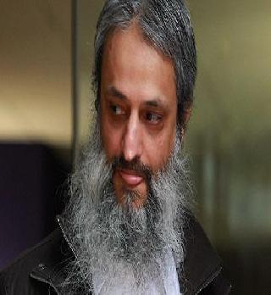

Slide 33
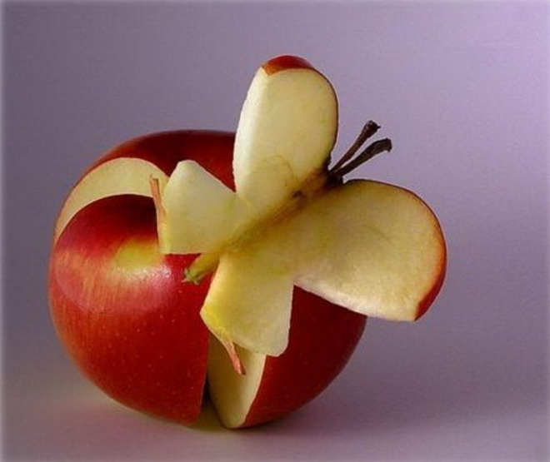
Inside each one of us endless creativity waiting to be disclosed

Slide 35
Finally Start again and …!!!
????????????

Slide 36
Socialize

Slide 37
Thank You

