Slide 1
Navigating the Educational AI Wave: Change Management and Embracing Resistance
Nadine Haidar PhD.

Slide 3
Key Takeaways
Identify the concept of change and its necessities.
Understand and recognize the change process within organizations in different areas and identify the reasons for this.
Understand methods of managing and reducing the resistance of individuals to change in the workplace.
Professional development opportunities.
Recognize the behavior of individuals during the change phase.

Slide 5
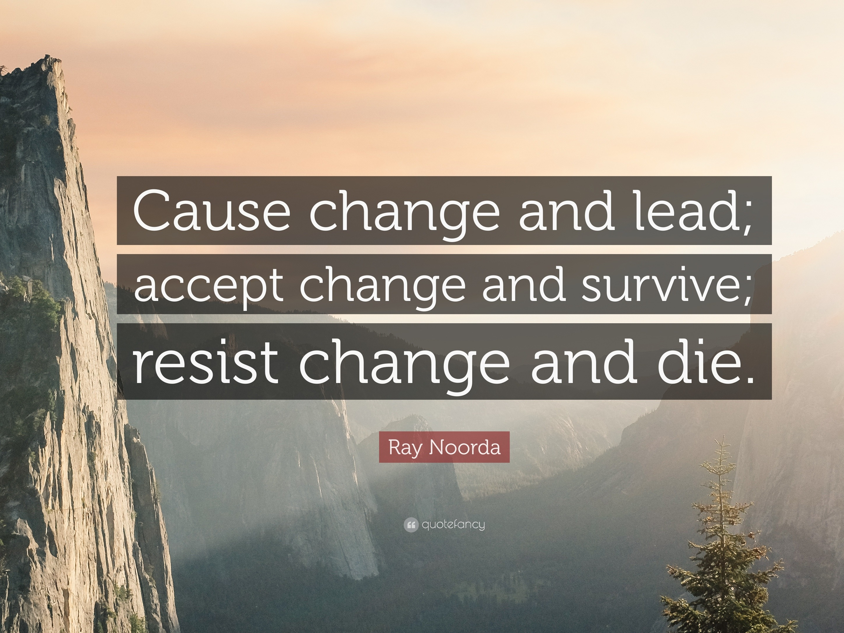

Slide 7
“It is not the strongest of the species that survive, nor the most intelligent, but the one most responsive to change.”

Slide 8
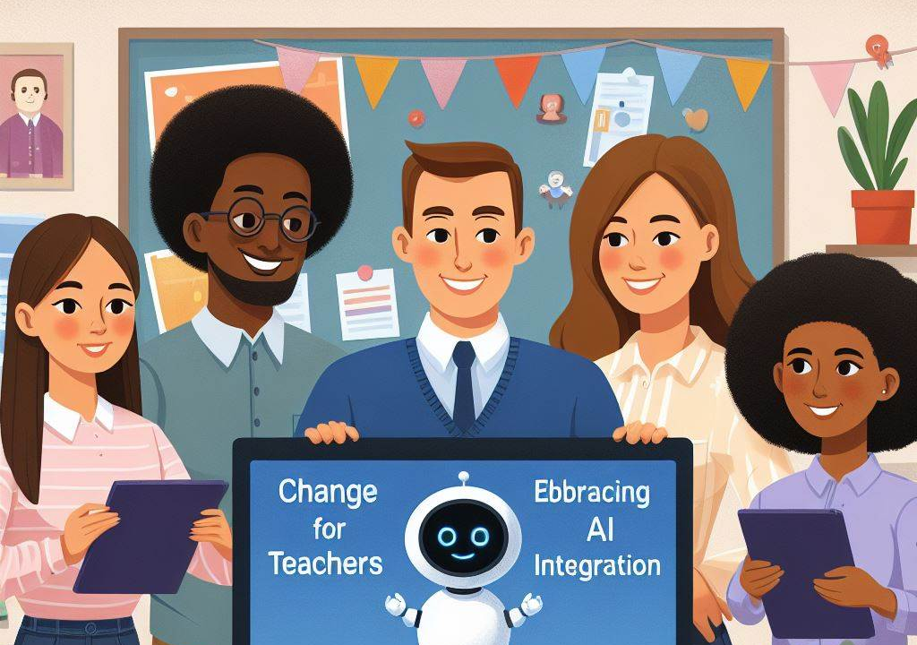

Slide 10
This is an exciting time for education
Together we can ensure a smooth transition that benefits both teachers and students

Slide 11
Why we need CHANGE?
Why do people resist CHANGE?

Slide 12
Managing resistance to change is essential to the success of all change efforts in each company. Dealing with resistance largely depends on your ability to recognize the real sources or causes of resistance to change.

Slide 13
Organizational change is an activity of transformation or modification of something in your organizational system. The primary purpose of this activity is to improve your business performance. You can’t find a person who would like to implement change if that change process brings results with which the organization will become worse or there will not be any improvements.

Slide 14
Why We Need Organizational Changes?

Slide 15
An organization, business, or company is interacting with its environment. Each environmental change will affect the organization’s work and performance, and because of that, the organization will need to adapt to changes in the environment.

Slide 16
So, organizational change is the activity of differentiation or modification of the organization to bring improvements to overall business processes and adapt to the ongoing environmental changes.

Slide 17
How do People Respond to Organizational Change?
Managing resistance to change recognizes four types of persons regarding their responses to changes. So, we can have:

Slide 19
1. Persons who will initiate the change process.
Everyone wants to have such people in their company. Even though they know that the change process is not easy, they want to change the way how they work so the organization can stay competitive in the market. They always try new things and experiment with new things to change the current status quo situation.

Slide 20
You need to remember that these people are the ones who will initiate the change process. Your job as a manager will be to focus on helping them bring the change process to the table.
These people are leaders committed to making a change and will begin to act on their commitments. Commitment means they’ll take the necessary actions to turn their intentions into reality.

Slide 21
2. Persons who will accept the proposed change.
On the other side, you will have people who accept the proposed changes, no matter how they impact their own jobs. If the first group of people are leaders, then this group of people are followers. They follow change agents or change initiators and help them in their intentions to change the organization.

Slide 22
3. Persons who will be indifferent to the proposed change.
Also, many organizational members will be indifferent to the proposed changes. I don’t know how to define these people because they can accept or resist changes.
So, your job is to find these people and explain to them the benefits of the change process, their role in the process itself, and what they will get after the implementation.

Slide 23
4. Persons who will not accept the proposed change.
In the end, you will always have people who will not accept the proposed changes, no matter how they impact their future. Many people will be unsure about the process and its outcomes. Also, they can not see anything good for them as an outcome. They will become resistant to proposed changes.

Slide 24
You will need to identify these people and talk with them to explain why there is a need for organizational change. You need to amortize their impact on the success of the change process.
Those who do not belong to any of the above-mentioned categories are more likely to resist proposed changes and simultaneously accept or initiate other types of changes.

Slide 25
The Landscape of Change

Slide 26
AI In Education Statistics (Editor’s Picks)

Slide 28
In the next three years, over 47% of learning management tools will be powered by AI.

Slide 29
Research shows that 20% to 40% of the current workload of teachers can be automated using current technology.

Slide 30
An AI-enabled chatbot can respond to a student’s question in a mere 2.7 seconds.

Slide 31
The global market value of AI in education is expected to grow by over 45% CAGR ( Compound Annual Growth Rate) between 2022 and 2030.

Slide 32
86% of educators state that technology, including AI, must be a vital component of education.
(Datamation)

Slide 33
When the COVID-19 pandemic hit, the world was forced to turn to online options, and education was not exempt. This phenomenon gave the final push that school boards needed to embrace various technologies in education, including AI.
With a multitude of benefits, AI is proving that it has a place in the education sector.

Slide 34
Preparation is the area with the most significant automation potential in education, with a reduction of up to five hours from teachers’ current work hours.

Slide 35
The global market value of AI in education surpassed $2 billion in 2021.
(Global Market Insights)

Slide 36
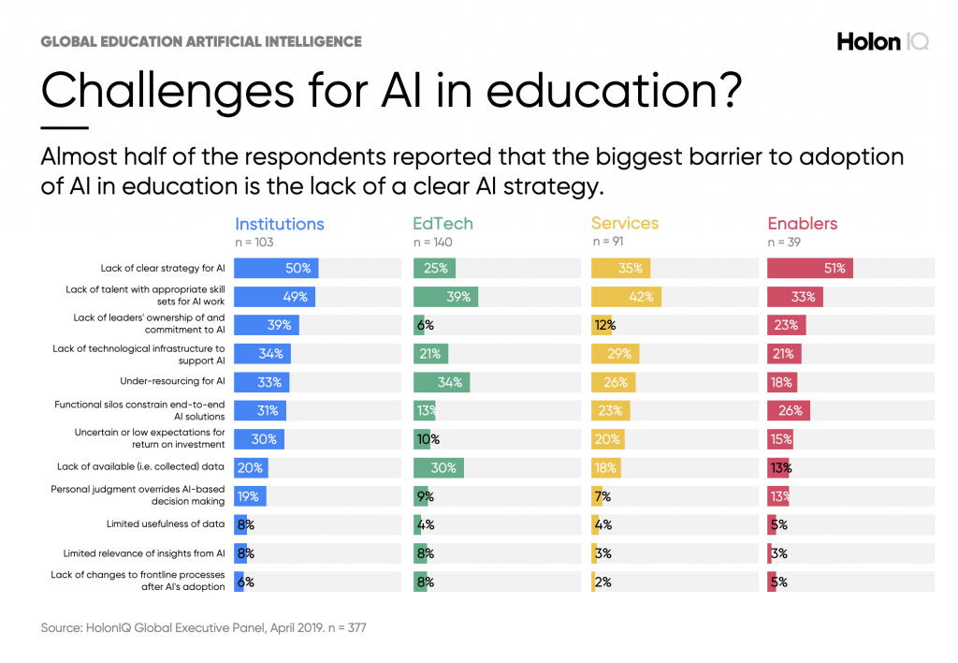

Slide 37
How is AI being used in education?
Artificial intelligence can supplement high-quality instruction and learning materials to improve education. It can be used in personalized learning, creating smart content, automating tasks, and identifying weaknesses in the classroom. AI also provides 24/7 assistance to students on various topics.

Slide 38
Change can be challenging, but with proper planning, we can make it successful.

Slide 39
Strategies for Managing Change

Slide 40
-1-
Communication is the Cornerstone of Any Change

Slide 41
Open and transparent communication is essential for successful change management.

Slide 42
Present a clear vision of how AI will be used in the classroom.

Slide 43
Clearly explain the goals and benefits of AI integration.

Slide 44
Outline a detailed implementation plan with training opportunities.

Slide 45
Address teachers’ concerns and questions honestly.

Slide 46
Facilitate open communication channels to address concerns and gather feedback.

Slide 47
Encourage open dialogue and feedback throughout the process.

Slide 48
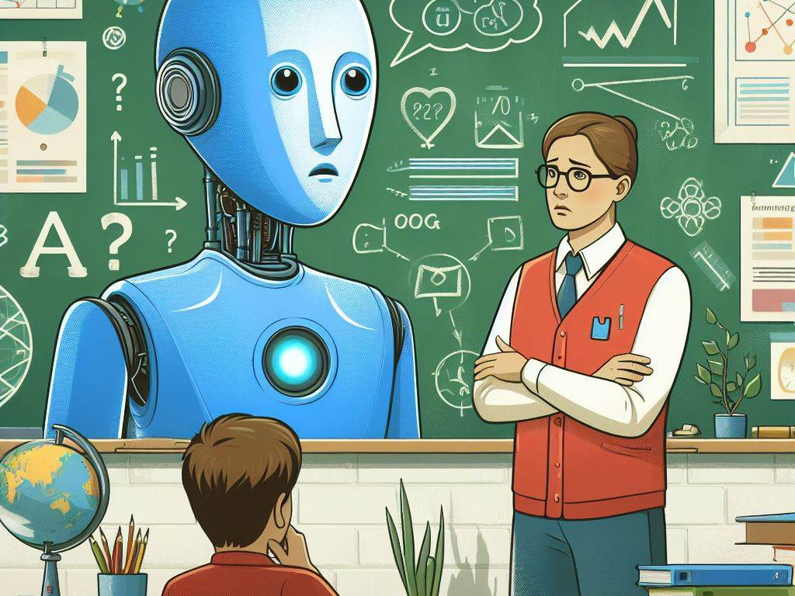
Understanding Teacher Concerns

Slide 49
AI empower teachers,
Not replace them

Slide 50
-2-
Focus on Professional Development Opportunities

Slide 51
Offer training workshops on using AI tools effectively.

Slide 52
Equip teachers with skills to create engaging lessons alongside AI support.

Slide 53
Ensure training is practical and addresses teachers’ specific needs.

Slide 54
Highlight opportunities for professional growth through AI integration.

Slide 55
Offer ongoing support and resources to build teacher confidence.

Slide 56
Encourage Collaboration and knowledge sharing among teachers.

Slide 57
-3-
The Power of Pilot Programs

Slide 58
Start with a pilot program in a specific grade level or subject.

Slide 59
Pilot programs allow for controlled testing of new technologies.

Slide 60
Start with small, manageable groups of teachers and students.

Slide 61
Encourage collaboration among teachers to share best practices an experiences.

Slide 62
Gather feedback on the program based on findings.

Slide 63
Celebrate successes and address challenges collectively.

Slide 64
Share pilot programs successes to build momentum and address concerns.

Slide 65
Diagnosing Your Own Immunity of Change

Slide 66
Overcoming Your Immunity to Change

Slide 67
Thank You!

